Slide 1




FELIX MUKUNGU
Founder, The Core
Bitcoin Eductor
Graphic Designer
MukunguFelix
Felix Divoar
felixdivoar

Slide 2
Why Bitcoin is a game-changer in the financial world, particularly in parts of the world where the traditional banking system is ineffective. In poor communities, traditional banks are often unwilling to cater to the needs of the people due to the high costs of compliance imposed by regulations. As a result, a significant proportion of the population is left without access to essential financial services.
Additionally, cross-border remittances into countries like El Salvador are not only expensive but also time-consuming.
Hyperbitcoinization is a theoretical future where Bitcoin becomes the dominant global currency. This would mean that bitcoin would be used by everyone, everywhere, and for everything - from buying coffee to paying bills and even to buy a house.

Slide 3
Here are some of the benefits of a hyper-bitcoinized world
A Revolution in the Remittance Market: The remittance market involves the transfer of funds from one party to another, often across international borders. Bitcoin has the potential to revolutionize the remittance market by reducing costs to near-zero
through its Lightning Network layer 2 protocol. The Lightning Network offers fast and low-cost transactions, making it well-suited for the remittance market and addressing the high costs and other challenges associated with remittances, such as slow settlement times and restrictions on business hours.
A Self-Sovereign Future: A self-sovereign future is one where individuals have full control over their own digital identity and assets. It could lead to greater financial inclusion, privacy, and security, and increase the value placed on privacy in transactions.

Slide 4
Changes in Monetary Policy: If Bitcoin were to become widely adopted, it could challenge the ability of governments to control the money supply through traditional monetary policy tools, leading to changes in monetary policy management and implementation. It could also increase financial inclusion, equality, and opportunities, as well as reduce the ability of governments and financial institutions to manipulate the economy.
A Reliable Store of Value: Bitcoin’s digital scarcity makes it a reliable store of value, which could encourage more people to use it as a means of saving for the future.
Enhanced Transparency and Traceability: The tamper-proof and immutable record of all transactions on the blockchain could increase transparency and accountability in various industries
and sectors.

Slide 5
Improved Cybersecurity: The decentralized structure of Bitcoin makes it less vulnerable to hacking and data breaches, improving overall security.
Reducing Carbon Footprint and Promoting Renewable Energy: By making the process of mining for bitcoin more sustainable and environmentally friendly, miners can help to reduce its carbon footprint and promote the use of renewable energy sources. This aligns with important environmental, social, and governance (ESG) considerations.
The Lindy effect
The Lindy Effect is a simple theory that says the longer something has been around, the more likely it will continue to be around in the future. This theory can be applied to many things, including Bitcoin.

Slide 6
Bitcoin, a decentralized digital currency that has been around since 2009, is a prime example of the Lindy Effect in action. Despite facing numerous challenges over the years, including technological changes, security breaches, and government regulations, Bitcoin has continued to grow in popularity and has been adopted by an increasing number of businesses as a means of payment.

Slide 7
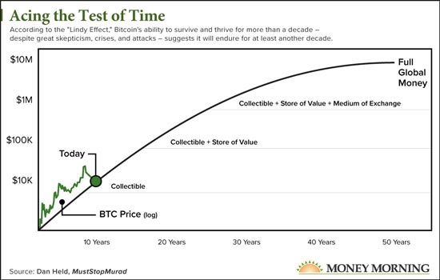

Slide 8
One of the key reasons for Bitcoin’s longevity and continued use is its decentralized nature.This means that it operates as a secure and transparent financial system without the need for intermediaries, making it appealing to individuals who value financial privacy and control.
One of the key reasons for Bitcoin’s longevity and continued use is its decentralized nature. This means that it operates as a secure and transparent financial system without the need for intermediaries, making it appealing to individuals who value financial privacy and control.
Bitcoin’s hash rate has been increasing exponentially over the years and the distribution of mining is also becoming more widespread. The number of users joining the Bitcoin Network has also increased at an exponential rate, with an estimated 140-190 million users now a part of it. These factors, combined with its continued popularity and usefulness, suggest that Bitcoin is likely to continue being used and trusted into the future.

Slide 9
The Challenges
Privacy While bitcoin transactions are pseudonymous, the blockchain is publicly accessible, which means that it is possible for third parties to track the flow of funds and identify users. There are some proposed solutions to this problem, such as the use of coin mixing and stealth addresses, but they are not yet widely adopted.
Usability: For the average user, the process of setting up and using a full node can be quite technical and daunting. Simplifying the user experience and making it more accessible to a wider range of people could help to increase adoption.
Security: While Bitcoin Core is open-source, which means that its code can be audited by anyone, it’s still possible for bugs or vulnerabilities to be introduced into the code. Continuously auditing and improving the security of the software can help to protect users from potential attacks.

Slide 10
Overall, while Bitcoin Core is a solid piece of software, ongoing development and research is essential to address these areas of improvement and ensure that the network remains secure, decentralized and widely adopted.
Understanding the Energy Usage of Bitcoin Mining
Bitcoin mining uses a lot of energy, around 79 terawatts-hours per year. However, this does not necessarily mean that it is a waste of energy or harmful to the environment. Bitcoin mining can help to utilize unused capacity of energy, especially in remote or inaccessible places. Additionally, most Bitcoin mining is done with renewable energy such as hydroelectric, solar, wind, and geothermal. This helps to make the production and research of these energy sources more profitable. Furthermore,
Bitcoin mining provides security for the Bitcoin network, enabling people to have access to secure and accessible money.

Slide 11
The digital signature validation process, which is a small part of mining, uses minimal energy. The energy usage of Bitcoin mining is high, but it is not as high as other industries like the traditional financial system or gold mining and recycling. Miners are also increasingly using clean and renewable energy sources like geothermal and hydroelectric power to power their mining operations.
The key to reducing the environmental impact is to drive the demand for green energy, and as the industry grows, it’s leading to innovation in clean energy production and decreased pollution. It’s also important to note that the source of energy used by miners greatly impacts the ecological
impact. As the technology and industry evolve, more miners are using renewable energy sources such as hydroelectric, solar, and wind power, which greatly reduces the environmental impact

Slide 12
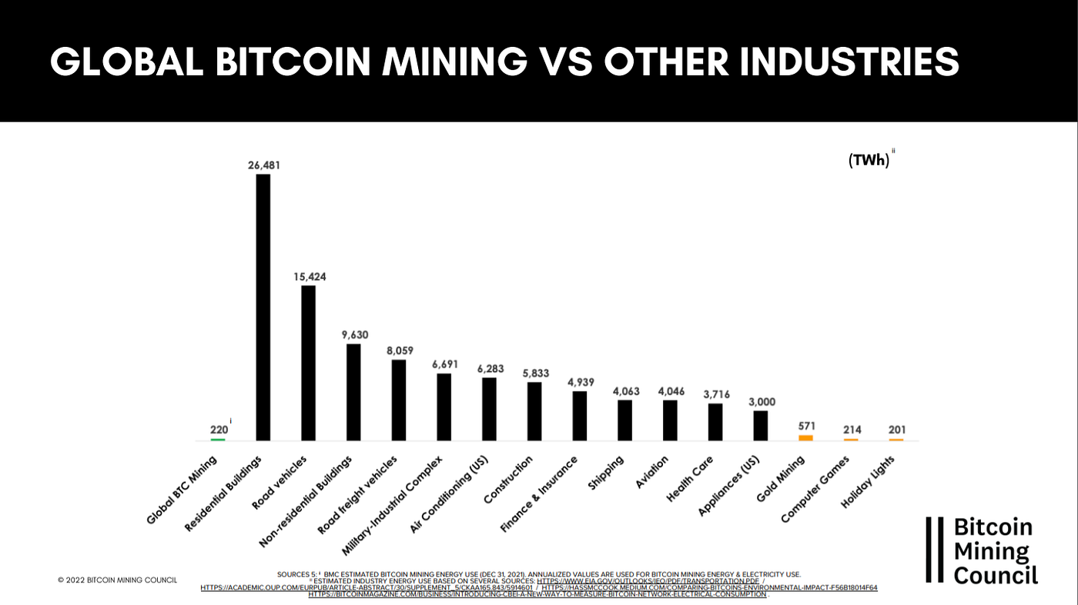

Slide 13
The Risks
Volatility: The value of bitcoin can be highly volatile and can change a lot in a short period of time, which can lead to significant losses for investors.
Lack of regulation: Bitcoin is not regulated by governments or financial institutions, which means there is little oversight to protect consumers.
Security risks: Bitcoin exchanges and wallets can be subject to hacking and theft, which can result in the loss of funds for users.
Scams: There are many scams related to Bitcoin that can lead to the loss of funds for investors.

Slide 14
Lack of understanding: Bitcoin is complex and can be difficult to understand for the average person, which can lead to poor decision making and potential losses.
Lack of acceptance: Bitcoin is not widely accepted as a means of payment, which limits its usefulness in everyday life.
Technical risks: Bitcoin is subject to technical risks like bugs and errors, which could lead to problems and potentially a loss of value.

Slide 15
Digital Threats: Hackers can exploit your internet connection to access your private keys and sensitive data, which includes hacking software wallets, clicking malicious links, and falling for spyware scams.
Social Engineering Scams: Scammers can manipulate you into confirming transactions by posing as customer service agents or creating a false sense of trust, so it’s important to be cautious and not share your recovery phrase.
Investing in bitcoin
The Hash/Price ratio and Price/Hash ratio are metrics used to compare the growth of the Bitcoin price and the growth of the Bitcoin Network’s computational power, or hash rate. These metrics are used to help understand the relationship between the two, and how changes in one may affect the other.

Slide 16
When the price of bitcoin increases at a faster rate than the hash rate, the Hash/Price ratio decreases and the Price/Hash ratio increases. This means that the price of bitcoin is growing faster than the computational power of the network, which could indicate increased demand for bitcoin.
However, near local peaks, when the price of bitcoin is increasing quickly, you may see sudden drops in the Hash/Price ratio. This is because the growth in price outpaces the growth in computational power, leading to a decrease in the Hash/Price ratio.
On the other hand, if both the hash rate and price of bitcoin decrease or increase at the same relative rates, the ratios will stay constant. This means that the computational power of the network
and the price of Bitcoin are growing at the same rate.

Slide 17
Dollar-cost averaging (DCA) is a strategy of investing a fixed amount of money into a particular asset at regular intervals, regardless of the price.
The goal of DCA is to reduce the impact of market volatility on an investment portfolio by spreading out the purchases over time, instead of buying all at once.

